Slide 1
INTERNATIONAL MEDTEC NETWORK
▲ CONSULTING ▲ DISTRIBUTION ▲ SERVICE ▲
www.medtec.com.de

Slide 2
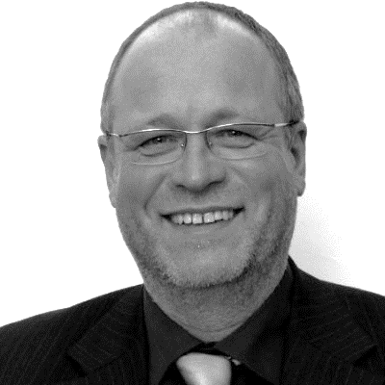
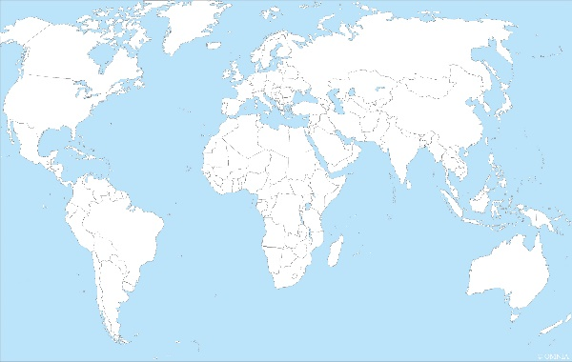
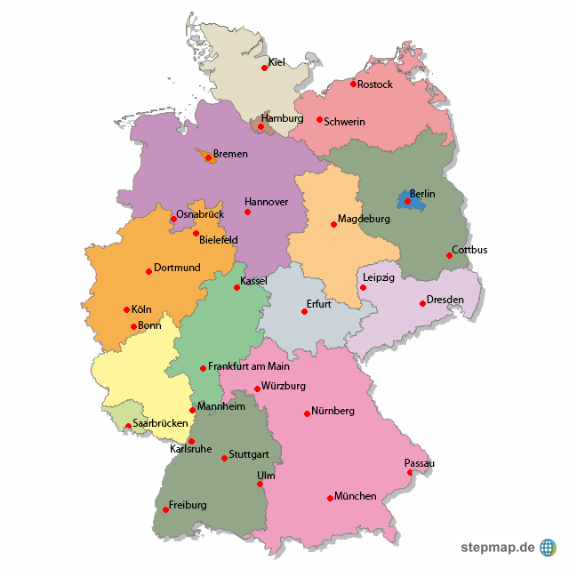
CURRICULUM VITAE
Dipl. Ing. Norbert Kuechemann
www.medtec.com.de

Slide 3
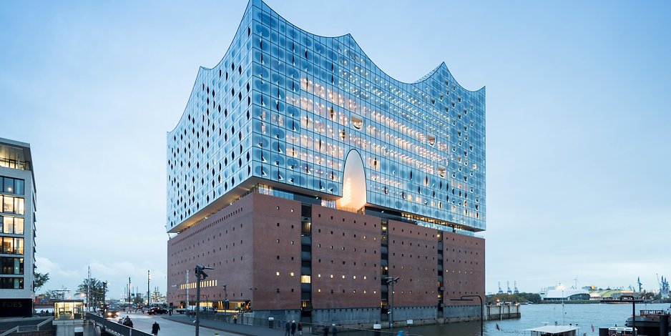
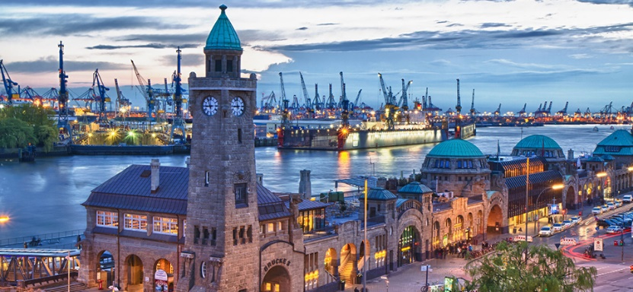
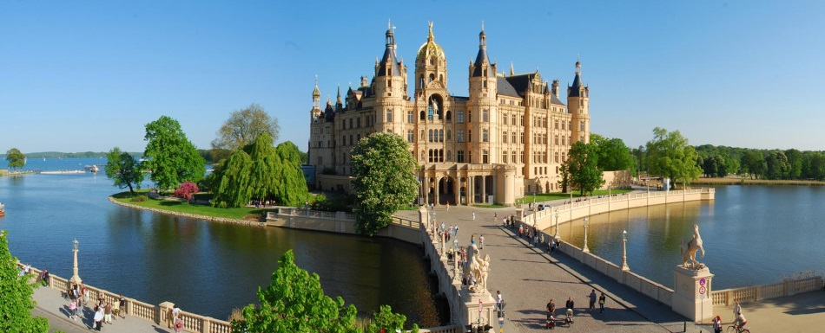
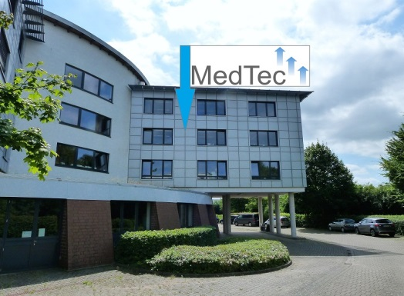
CURRICULUM VITAE
Dipl. Ing. Norbert Kuechemann
Hamburg
Schwerin
www.medtec.com.de

Slide 4
CURRICULUM VITAE
Dipl. Ing. Norbert Kuechemann
Master Degree (Diplom-Ingenieur)
Biomedical Engineering, University Hamburg
Graduate in Business Administration (Technischer Betriebswirt IHK)
Professional Career
2017 – now General Manager and Founder of MedTec, Hamburg, Schwerin, Germany
2014 – 2017 Director International Sales, TNI medical AG, Würzburg, Germany Devices for Therapy with Nasal Insufflation
1996 – 2014 Executive Director Marketing/Sales, Prokurist (Proxy Holder), Hoffrichter GmbH, Schwerin, Germany Sleep Therapy and Lung Ventilator Devices
1992 – 1996 Consultant, General Manager, NokTec, Hamburg, Germany Strategic Sales Concepts, Medical Product Launch, Presentation and Training, Print Media
1988 – 1992 Technical Development Engineer, Eppendorf-Netheler-Hinz GmbH, Hamburg, Germany
Device and Application Development, Product Training, Technical Marketing
1972 – 1988 Official, Government of Hamburg, Germany Ministry of Science and Research
www.medtec.com.de

Slide 5
We are
Engineers, Sales and Marketing Professionals
With many Years of Experience
National and International Expertise
Deep Market, Sales and Technical Knowledge
Highly Practical Orientated
In the Field of Medical Technology
www.medtec.com.de

Slide 6
Our mission
To enable our Clients to start Projects that they would otherwise not be able to start
Tailor-Made Solutions
Increase of Customer Effectiveness
High Transparency
www.medtec.com.de

Slide 7
Our Clients
German and International
Medical Technology Manufacturers
Sales and Service Provider Companies in the Medical Field
Start Up Enterprises
Well established Firms
www.medtec.com.de

Slide 8
Our network
International and Germany
Sales and Service Provider Companies
More than 400 Contacts in 90 foreign Countries
More than 90 Contacts in Germany
Total Network more than 500 Contacts
About 30 qualified Cooperation Partners worldwide
www.medtec.com.de

Slide 9
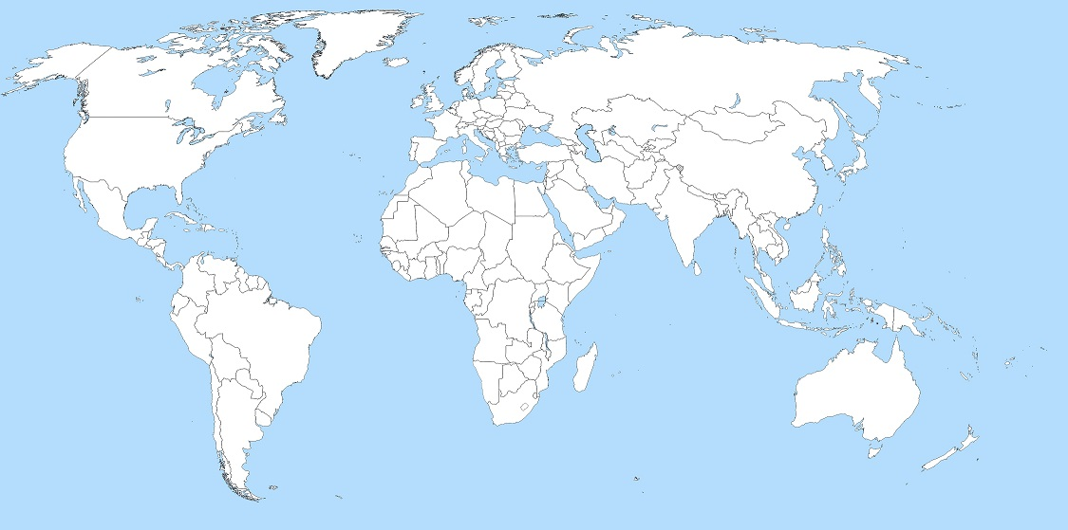
Contacts ALL OVER THE wORLD
Main Contacts
Contacts
www.medtec.com.de

Slide 10
Main Contacts in 25 Countries
Argentina
Belgium
Bulgaria (Greece)
China
Greece
Hong Kong
India
Indonesia
Iran
Israel
Italy
Japan
Kuwait
Malaysia
Netherlands
Philippines
Poland
Romania (Greece)
Saudi Arabia
Singapore
Spain
South Korea
Taiwan
Turkey
United Arab Emirates
www.medtec.com.de

Slide 11
More Contacts in 65 Countries
Egypt
Australia
Bahrain
Bangladesh
Bolivia
Bosnia-Herzigovina
Brasil
Chile
Costa Rica
Danmark
Ecuador
Estland
Finnland
France
UK
Iraq
Ireland
Iceland
Jordan
Canada
Qatar
Kenia
Columbia
Croatia
Lebanon
Lithuania
Luxemburg
Maledives
Malta
Marocco
Mauritius
Macedonia
Mexico
Moldavia
Montenegro
Myanmar
Nepal
New Zealand
Nigeria
Norway
Oman
Austria
Pakistan
Palestina
Panama
Peru
Portugal
Russia
Sweden
Switzerland
Serbia
Slovakia
Slovenia
Sri Lanka
South Africa
Sudan
Suriname
Syria
Czech Republic
Tunesia
Hungary
USA
Vietnam
Belarus
Cyprus
www.medtec.com.de

Slide 12
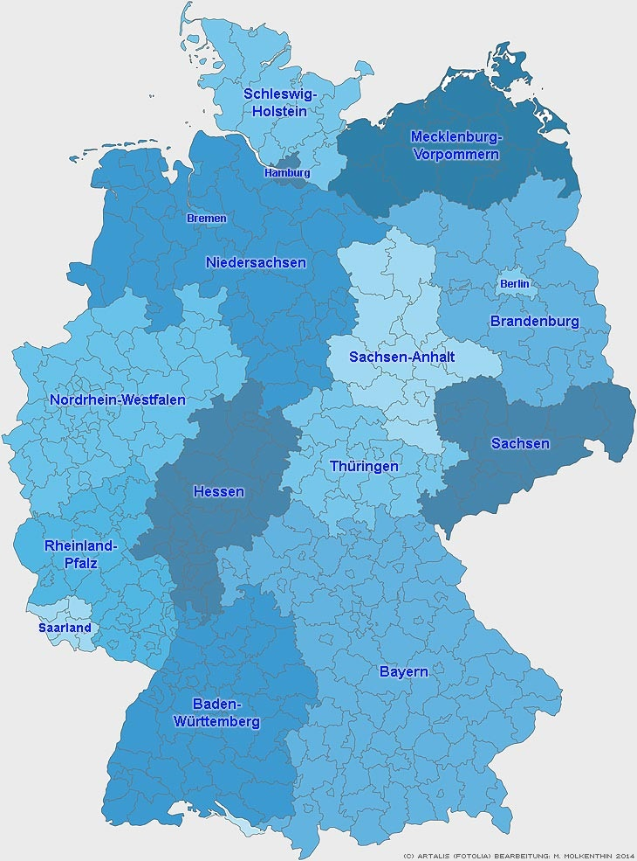
Contacts in germany
Schleswig-Holstein 7
Hamburg 3
Bremen 4
Niedersachsen 9
Mecklenburg-Vorpommern 4
Sachsen-Anhalt 2
Sachsen 6
Brandenburg 2
Berlin 1
Thüringen 4
Hessen 10
Nordrhein-Westfalen 14
Rheinland-Pfalz 8
Saarland 2
Baden-Württemberg 7
Bayern 15
www.medtec.com.de

Slide 13
Our services
Marketing
Market Analysis, Market Tests
Product-, Market- and Promotion Strategies
International Project- and Product Management
Sales National / International
New Customer Acquisition
Key-Account-Management
Product Training, Sales, Application, Technical Service
Technical Know-How
Respiratory Technology
Medical Technique Applications
Engineer Skills
Leadership
Executive Management
Human Resources Management and Acquisition
Value Chain Management and Optimization
www.medtec.com.de

Slide 14
Why cooperating with us
Discover new Market Chances
Develop your Market
Benefit by additional Business
Start Venture-Projects without Concerns
Profit by our customized Solutions tailored to your Needs
Reduce your Costs by avoiding permanent Staff
Fix Project Costs
Limit your Project Risk
Enjoy our full Transparency
www.medtec.com.de

Slide 15
THANK YOU FOR YOUR ATTENTION
and
WELLCOME
to
www.medtec.com.de

